Slide 1
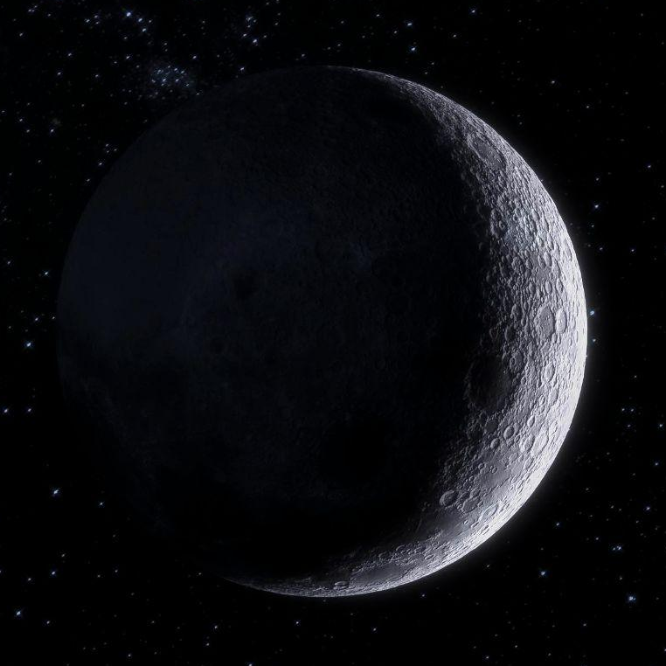
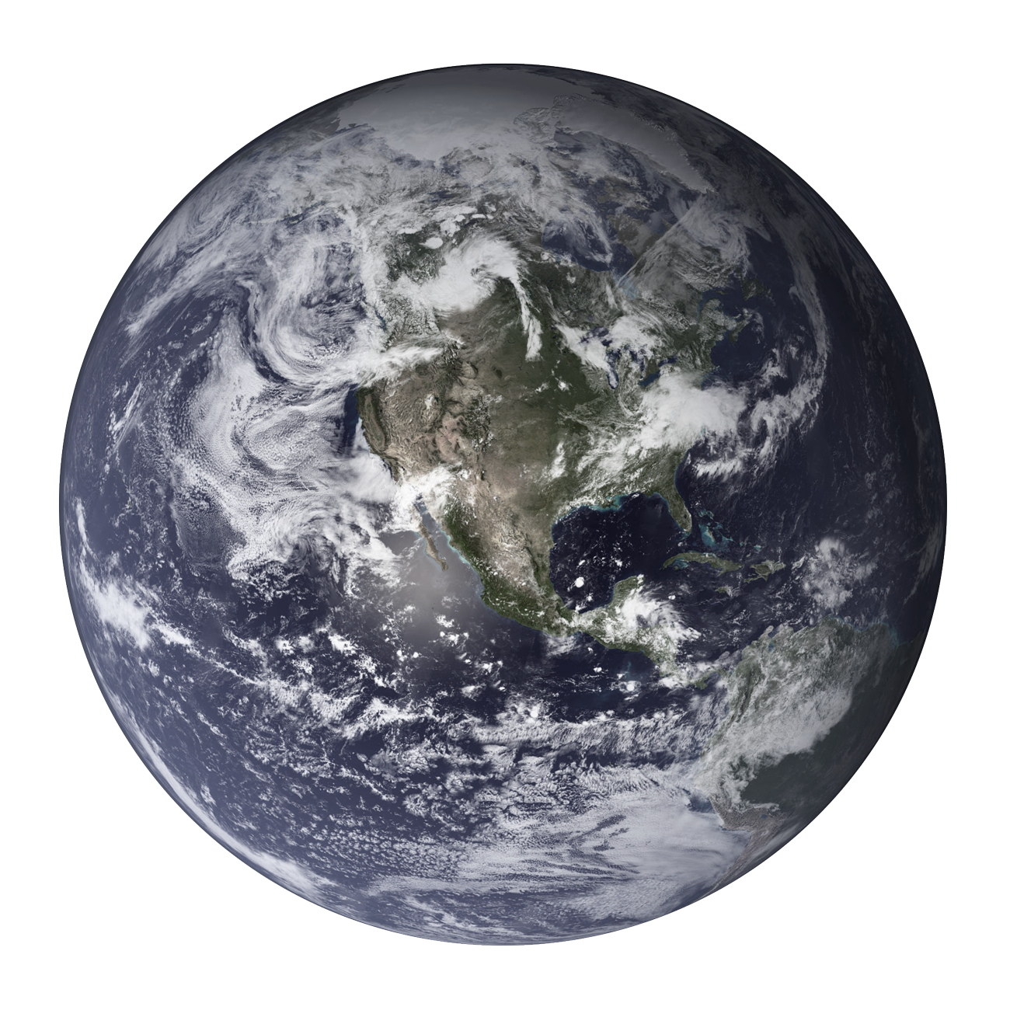
Satellite Image Segmentation
Capstone Project
Feng Weihan

Slide 2
TABLE OF CONTENTS
01
OVERVIEW
02
DATASET
03
MODELLING
04
CONCLUSION
What is Image Segmentation? What are some use cases?
Brief overview of the dataset
A look at the techniques for segmentation
What are the limitations and future explorations?

Slide 3
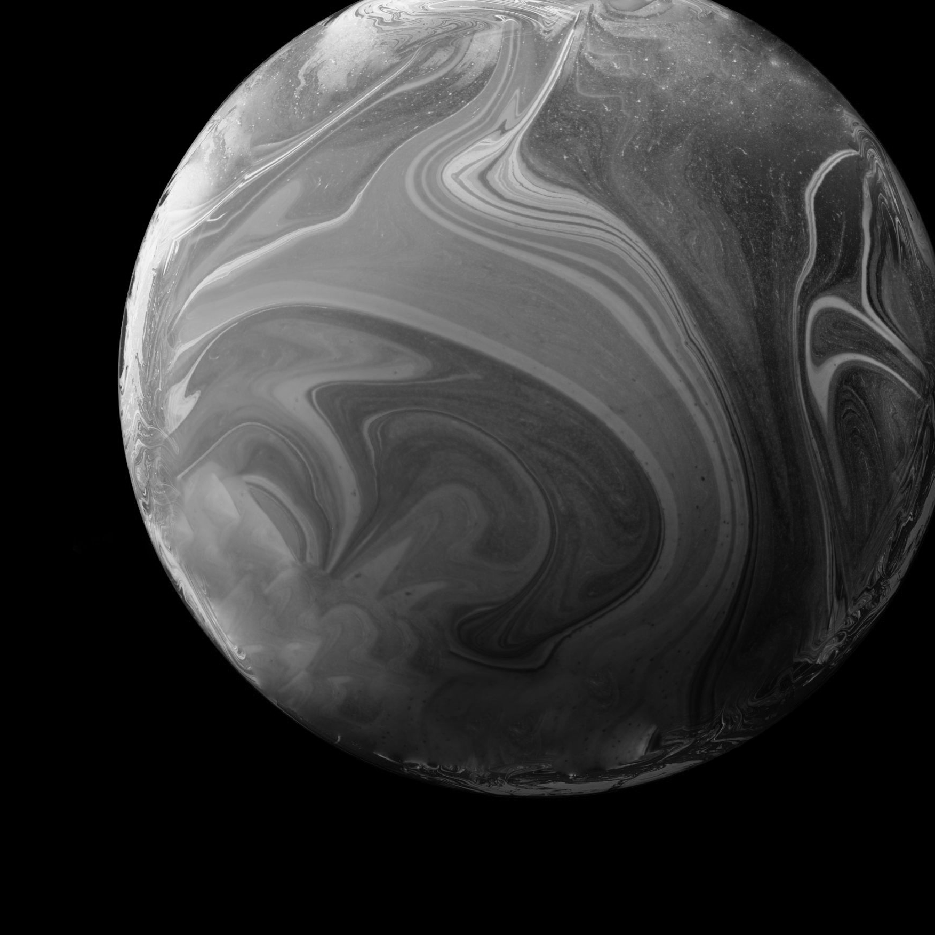
01
OVERVIEW
What is Image Segmentation? What is the use case?

Slide 4
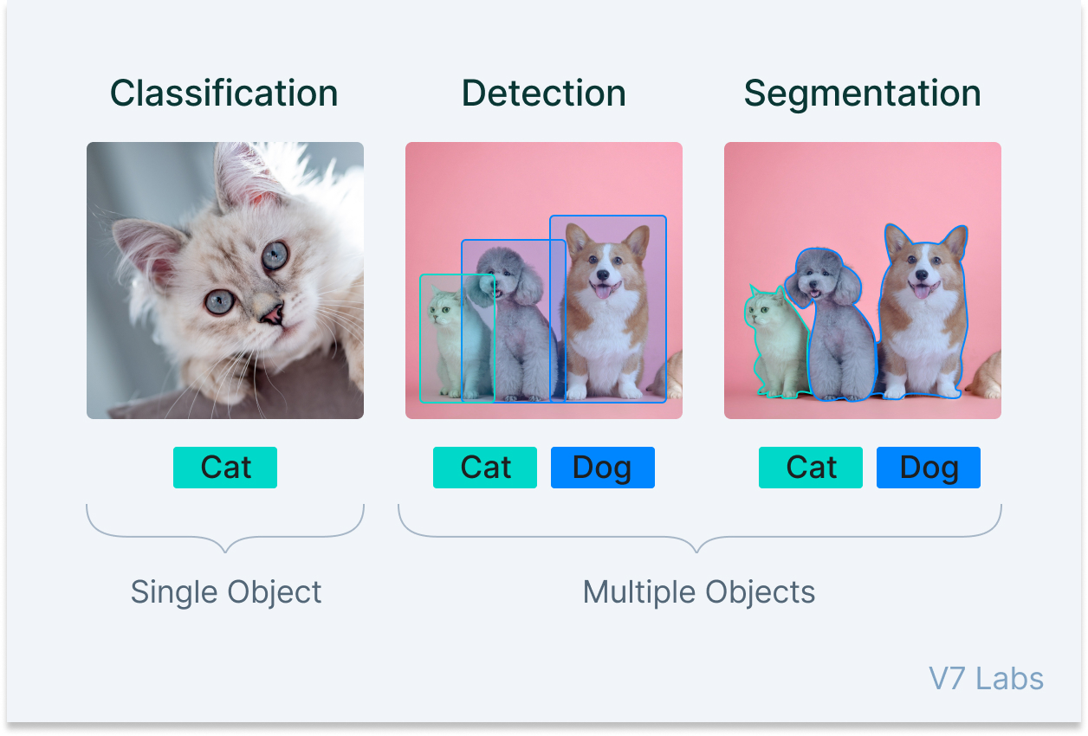
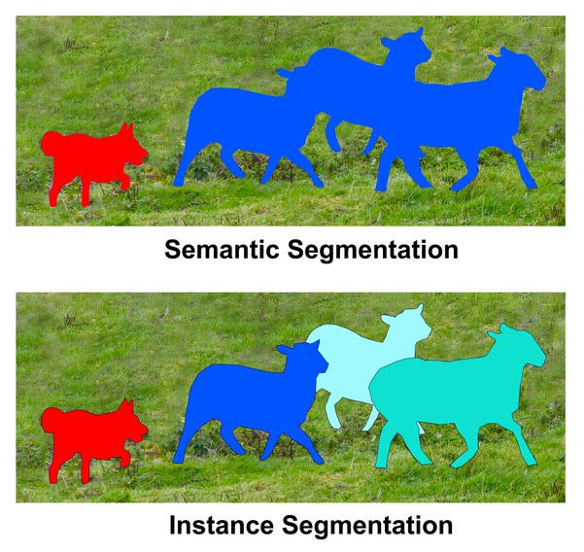
Types of Computer Vision Tasks
Notes:
https://www.v7labs.com/blog/image-segmentation-guide
- Each pixel is classified into a semantic category

Slide 5
Image Segmentation
Notes:
https://www.v7labs.com/blog/image-segmentation-guide
- Each pixel is classified into a semantic category

Slide 6
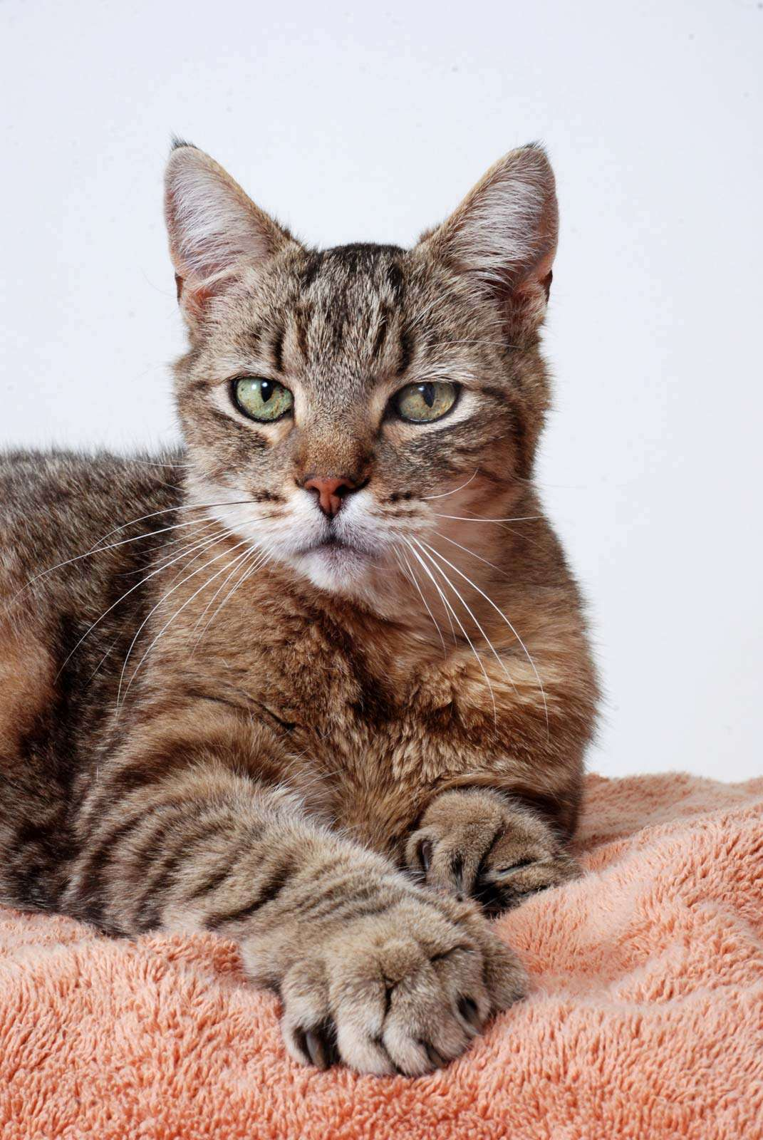
Semantic Segmentation
Cat | Background | Background
Cat | Cat | Background
Cat | Cat | Background
Classifying Individual Pixels

Slide 7
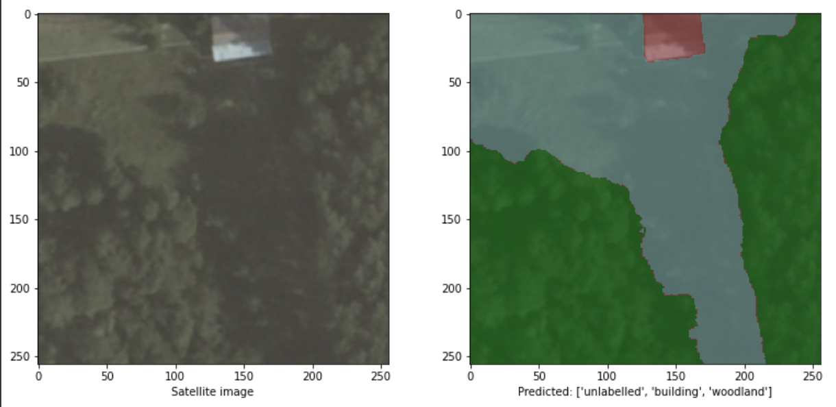
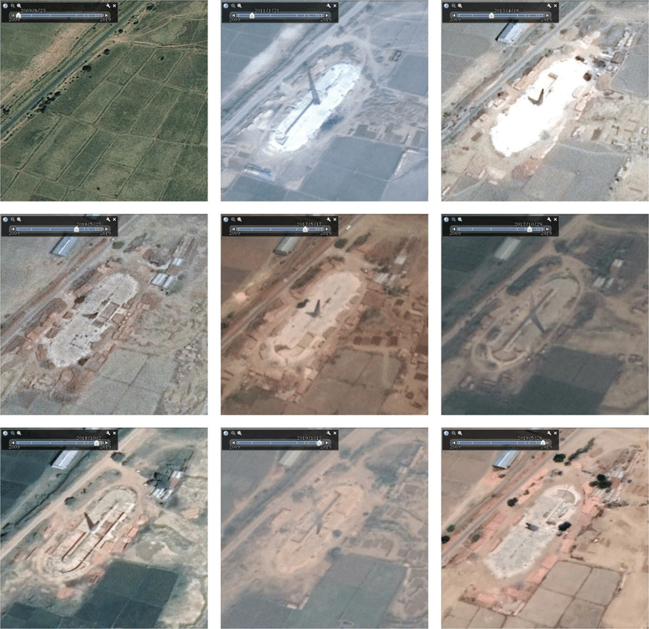
Semantic Segmentation on Satellite Imagery
What is it?
Segmenting satellite imagery into different classes of objects, i.e. woodlands, buildings, roads, etc.
Why might it be useful?
Monitor and quantify the changing state of our planet
Reduce manual work of tracing over satellite imagery in map production.
Notes:
https://www.britannica.com/list/the-10-best-types-of-cat

Slide 8
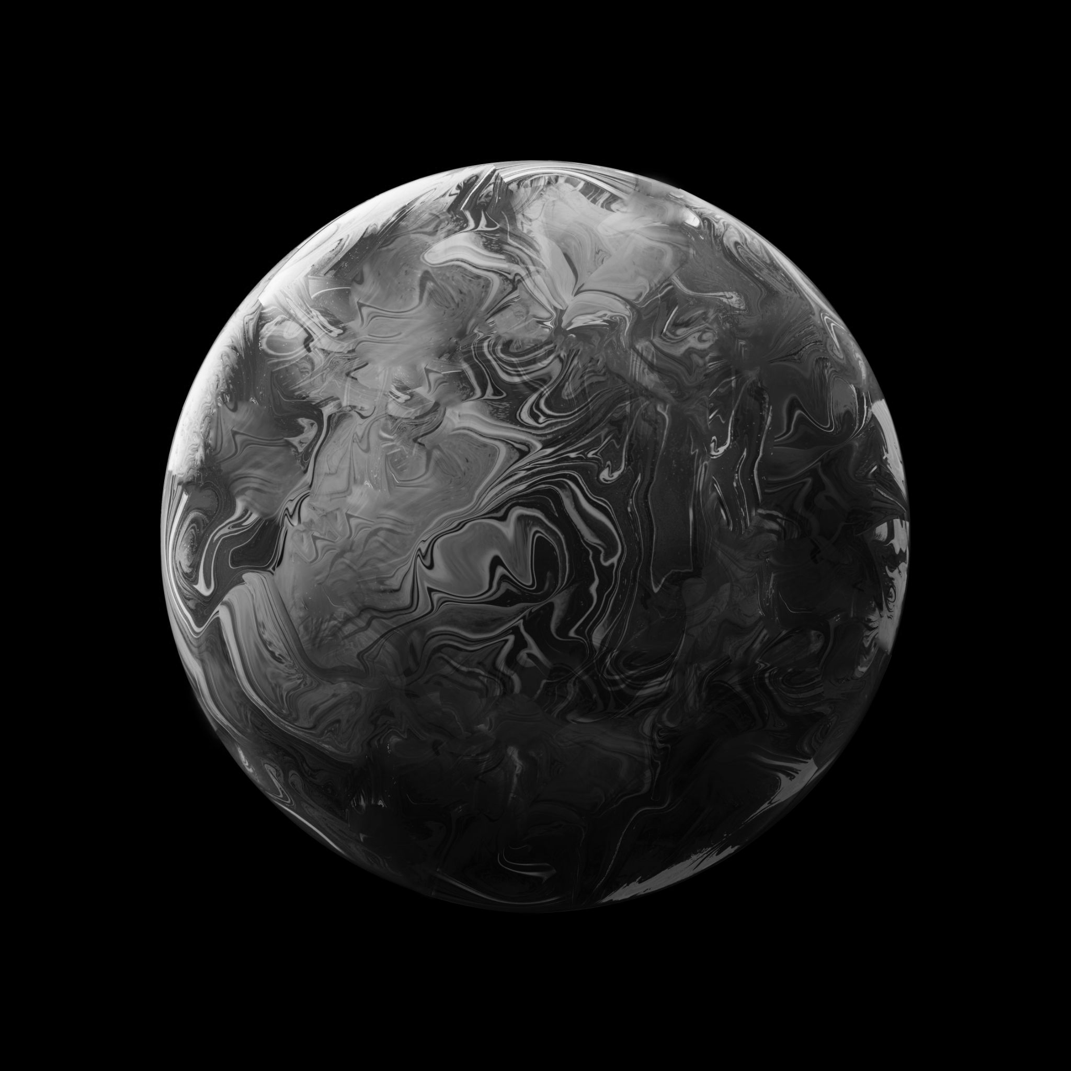
02
Dataset
Brief overview of the training dataset

Slide 9
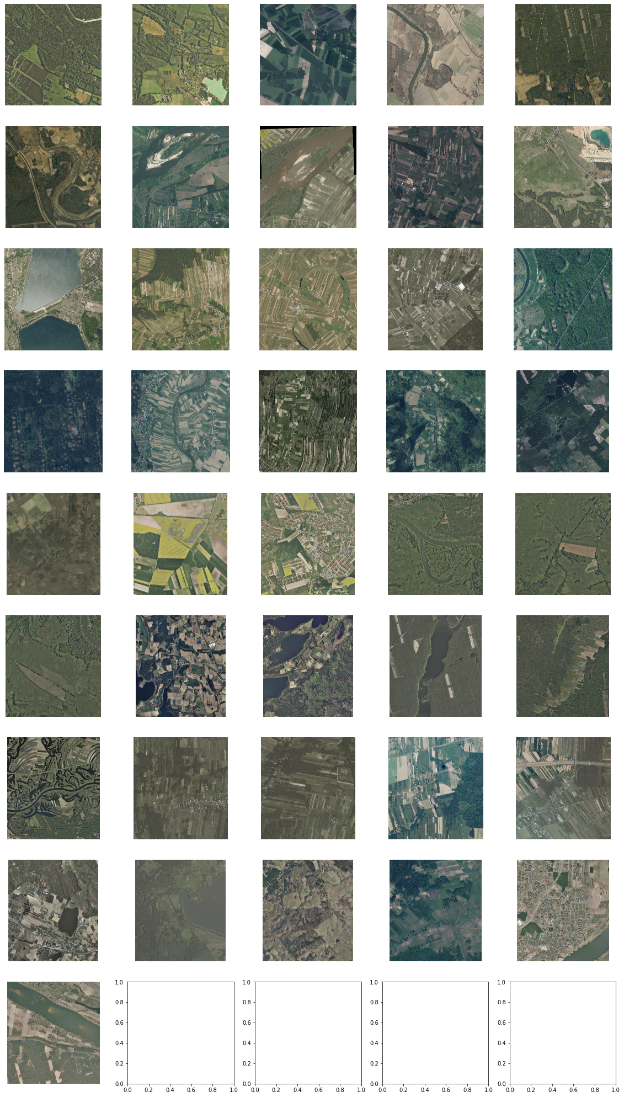
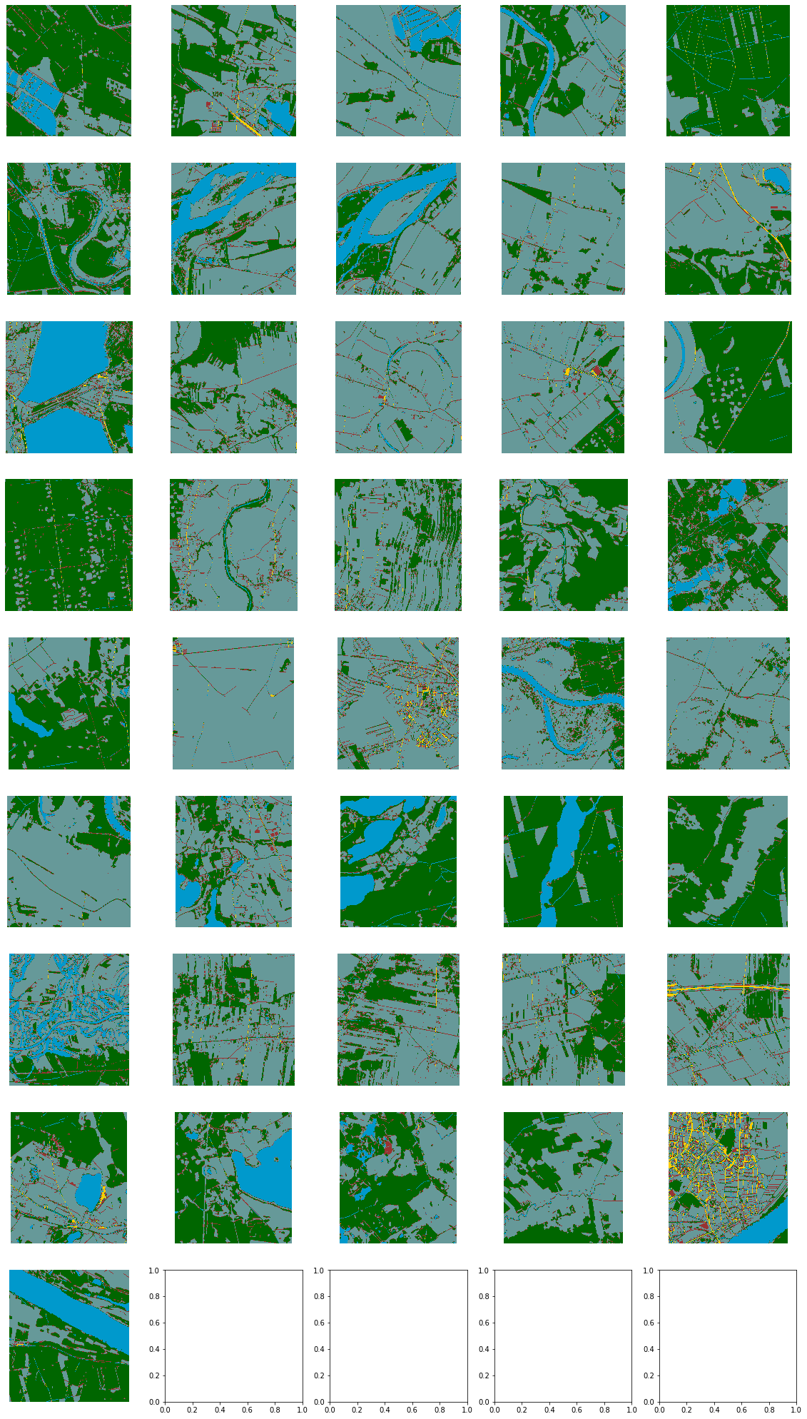
Types of Computer Vision Tasks
41
Images
41
Masks
Land cover from Poland, Central Europe
Provided by landcover.ai
33 X ~9000x9500 px
8 X ~4200x4700 px
5 Classes
Unlabelled (0)
Building (1)
Woodland (2)
Water (3)
Road (4)
Notes:
https://www.v7labs.com/blog/image-segmentation-guide

Slide 10
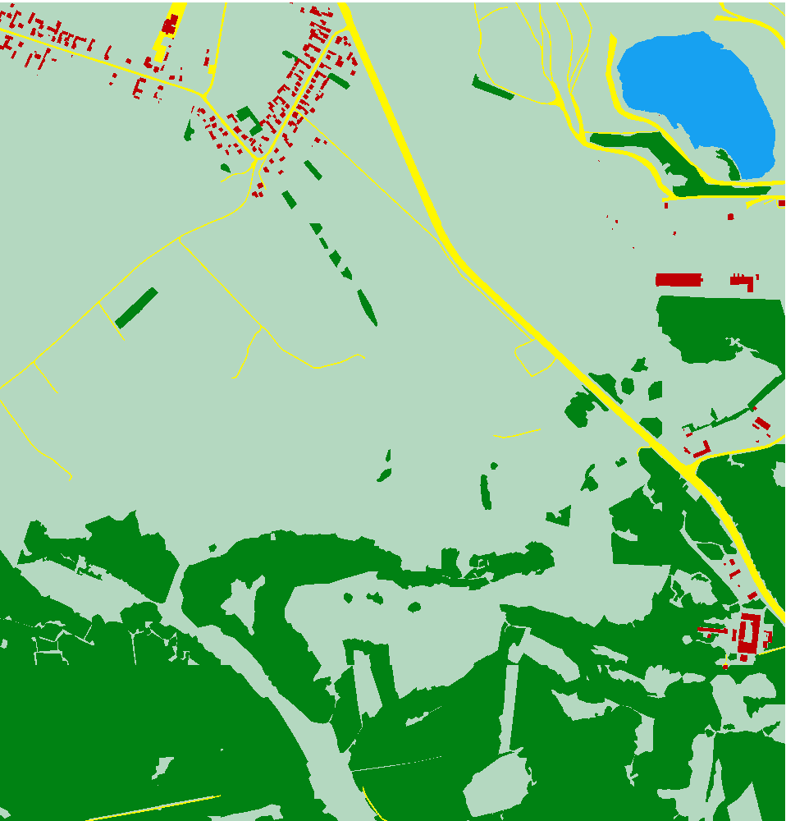
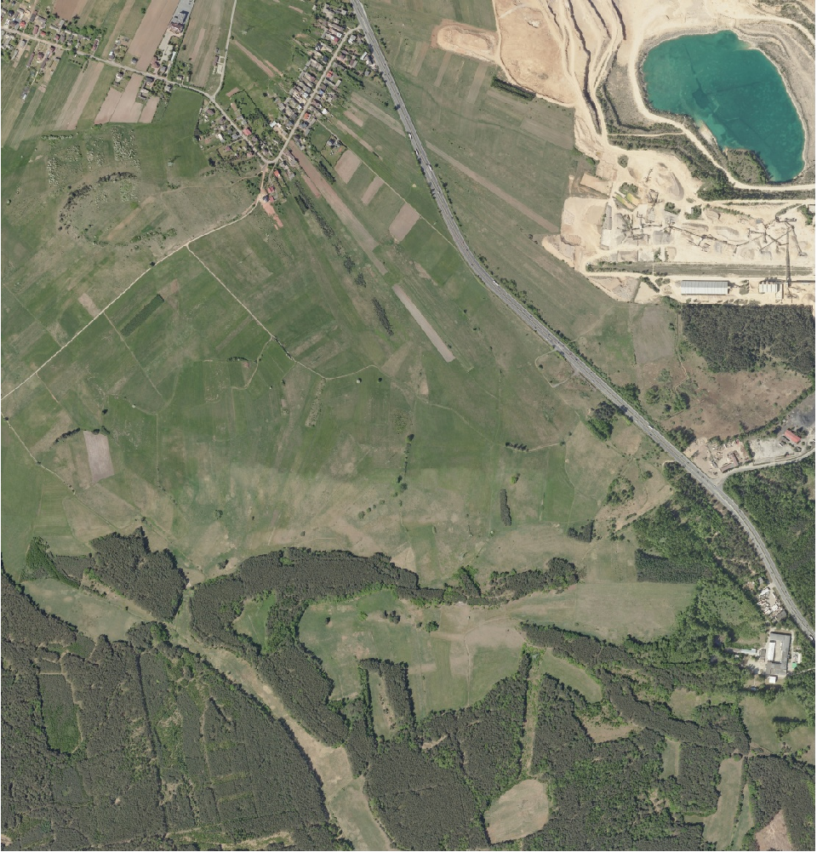
Further Processing
Only pick images with substantial variation of classes (>10%).
Random brightness and contrast augmentation.
34226 Training Images
2013 Validation Images
1007 Test Images
Divide full image into 256 X 256 pieces
Notes:
https://www.v7labs.com/blog/image-segmentation-guide

Slide 11
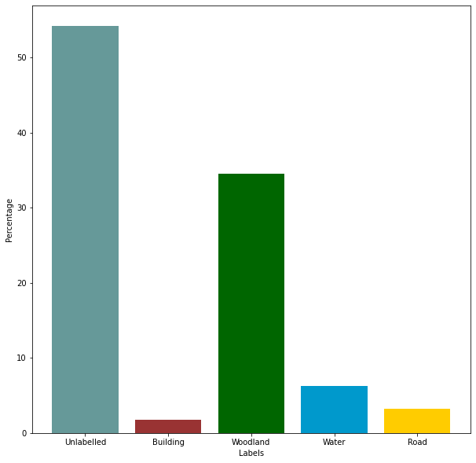
Proportion of Each Class
34226 Training Images
2013 Validation Images
1007 Test Images
Notes:
https://www.v7labs.com/blog/image-segmentation-guide
- The data consists mainly of rural and forested areas

Slide 12
03
MODELLING
A look at the techniques for segmentation.

Slide 13
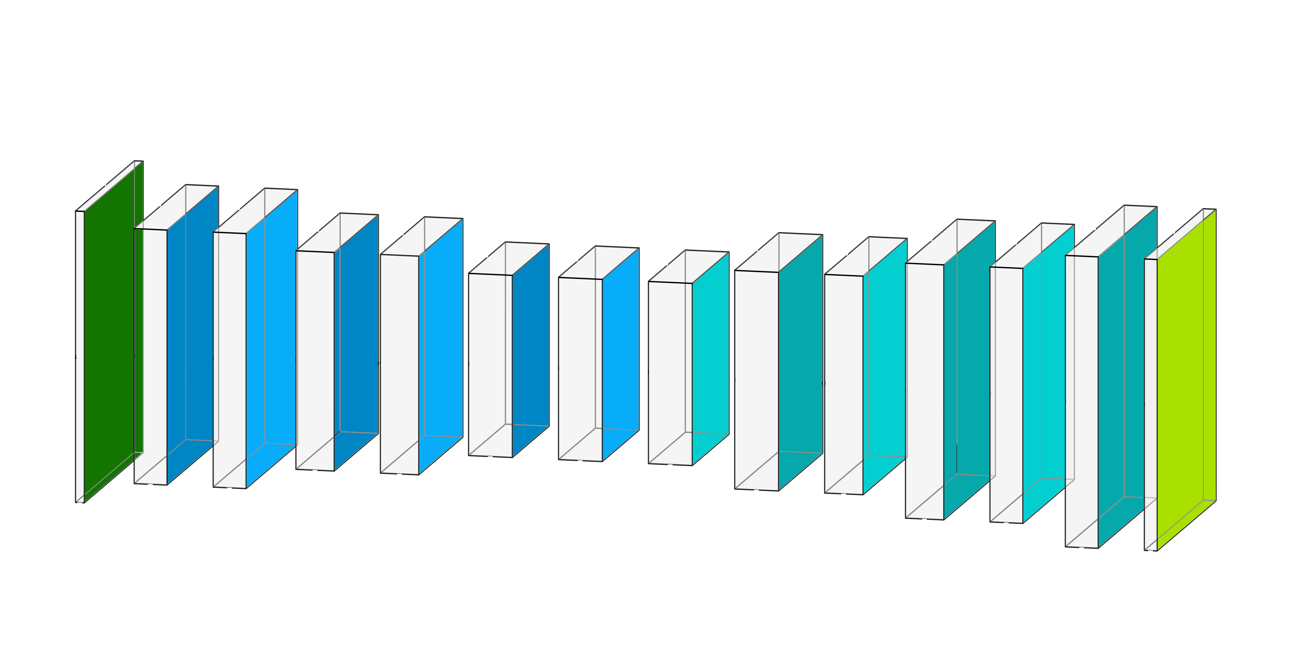
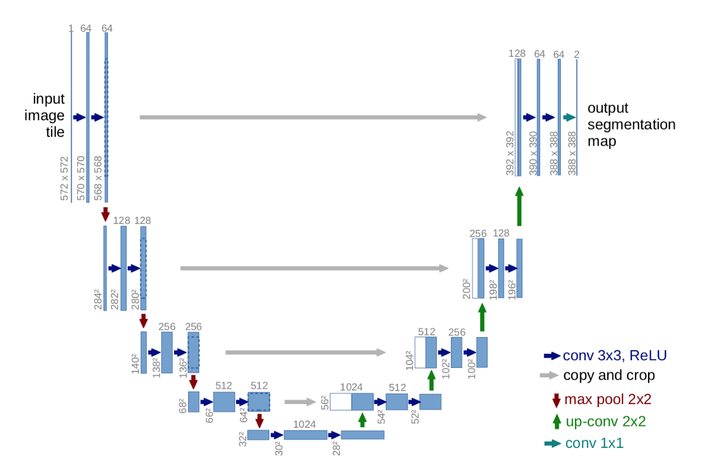
The Architecture
A basic Convolutional Encoder-Decoder Network
Unet
Input Image
Encoder
Decoder
Output Mask
(32,32,256)
Decoder
(256,256,3)
(128,128,64)
…
…
(128,128,64)
(256,256,64)
(256,256,5)
Convolution
2,881,797 params
34226 Training Images
2013 Validation Images
1007 Test Images
Convolution
With Stride 2
Encoder
Convolution Transpose
Convolution Transpose
With Stride 2
1,941,173 params
Notes:
https://www.v7labs.com/blog/image-segmentation-guide

Slide 14
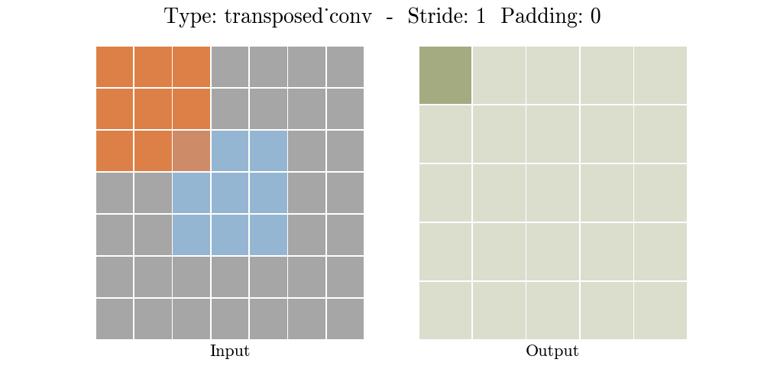
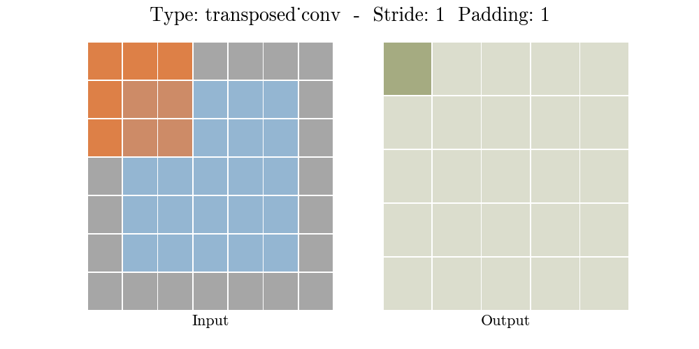
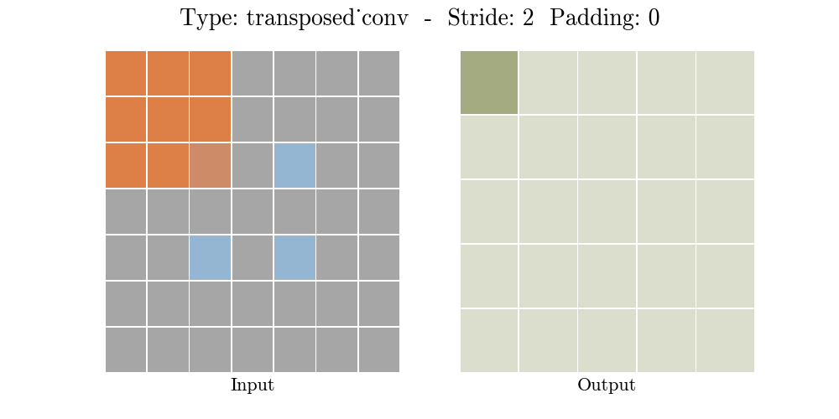
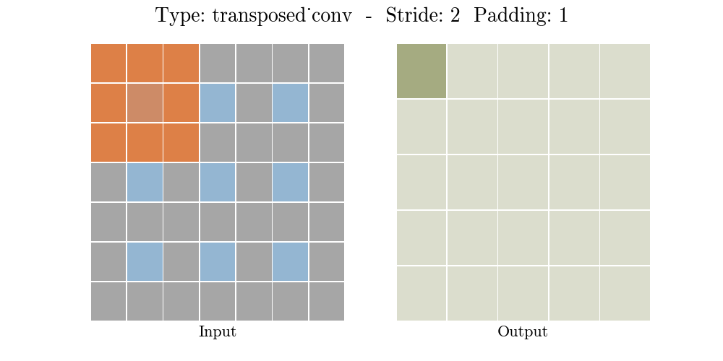
The Architecture
34226 Training Images
2013 Validation Images
1007 Test Images
Notes:
https://www.v7labs.com/blog/image-segmentation-guide

Slide 15

The Metric
Intersection Over Union (IOU) – Jaccard Index
Actual Mask
Predicted Mask
34226 Training Images
2013 Validation Images
1007 Test Images
Notes:
https://www.v7labs.com/blog/image-segmentation-guide

Slide 16
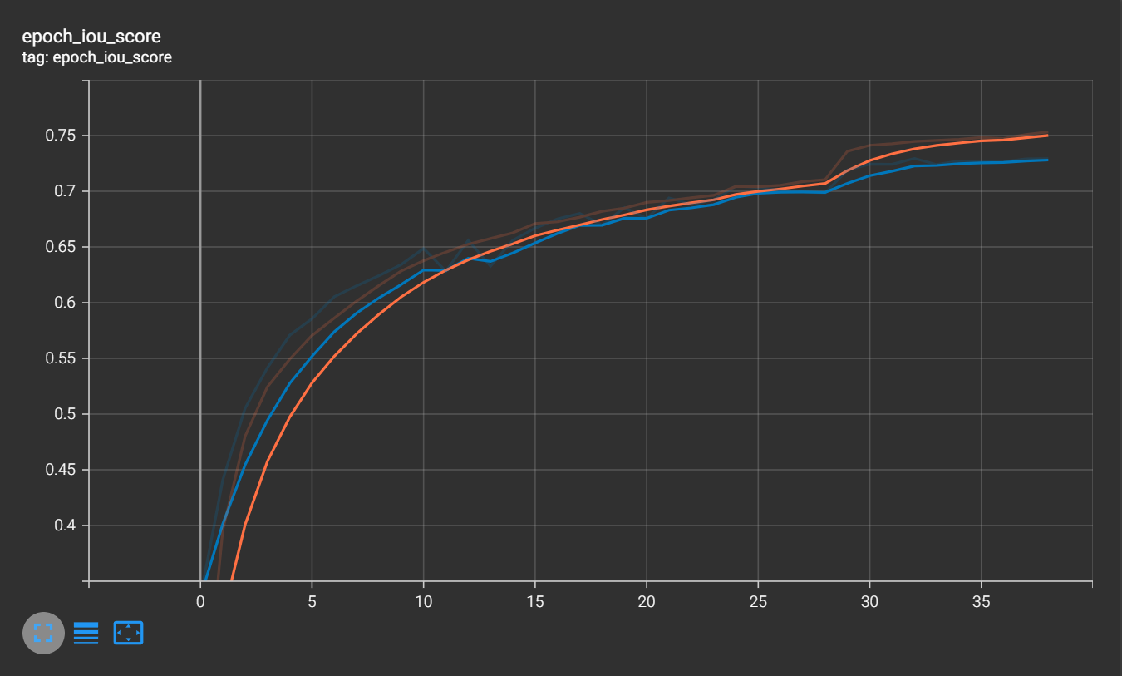
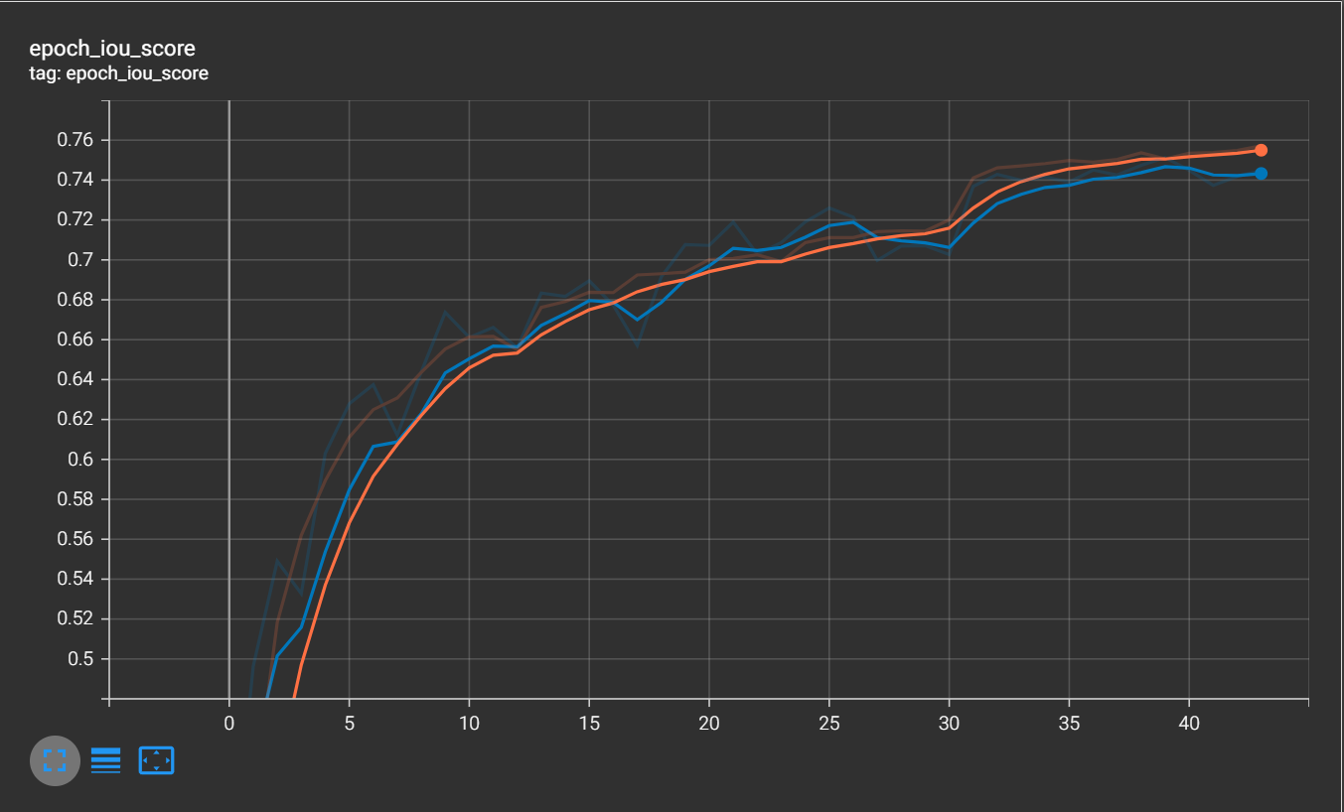
Evaluation
0.72++
BASIC
0.74++
34226 Training Images
2013 Validation Images
1007 Test Images
UNET
Notes:
https://www.v7labs.com/blog/image-segmentation-guide

Slide 17
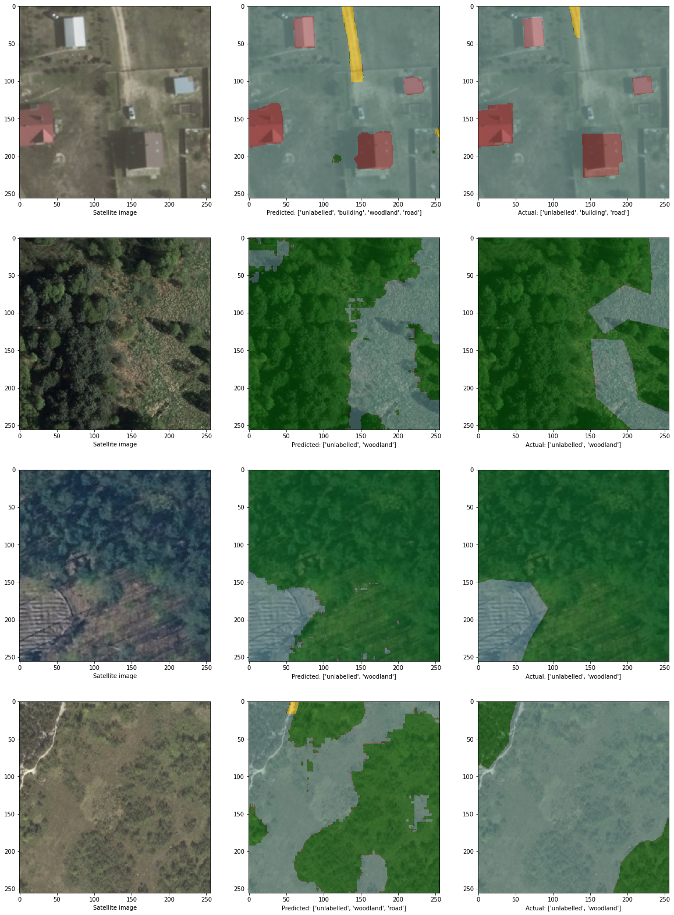
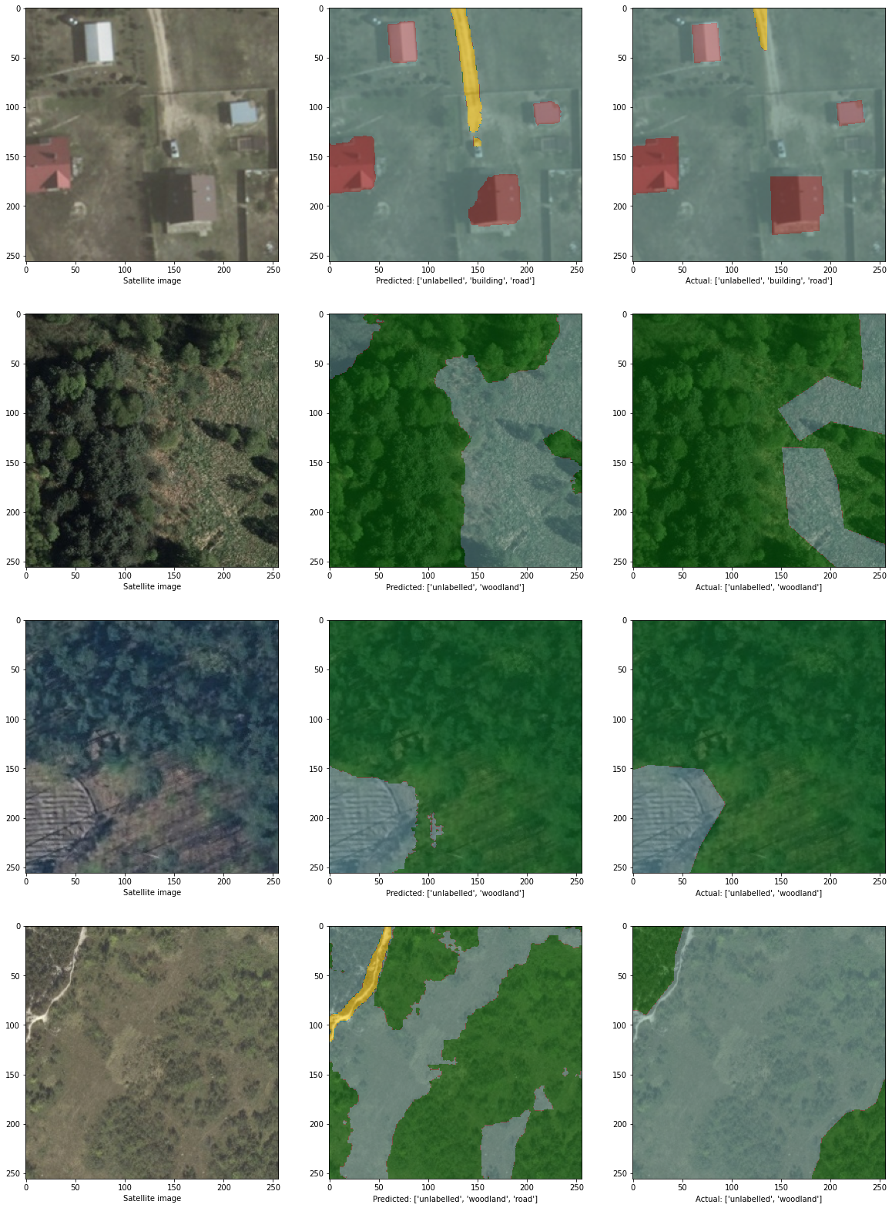
Evaluation
GROUND TRUTH
BASIC
UNET
34226 Training Images
2013 Validation Images
1007 Test Images
Notes:
https://www.v7labs.com/blog/image-segmentation-guide

Slide 18
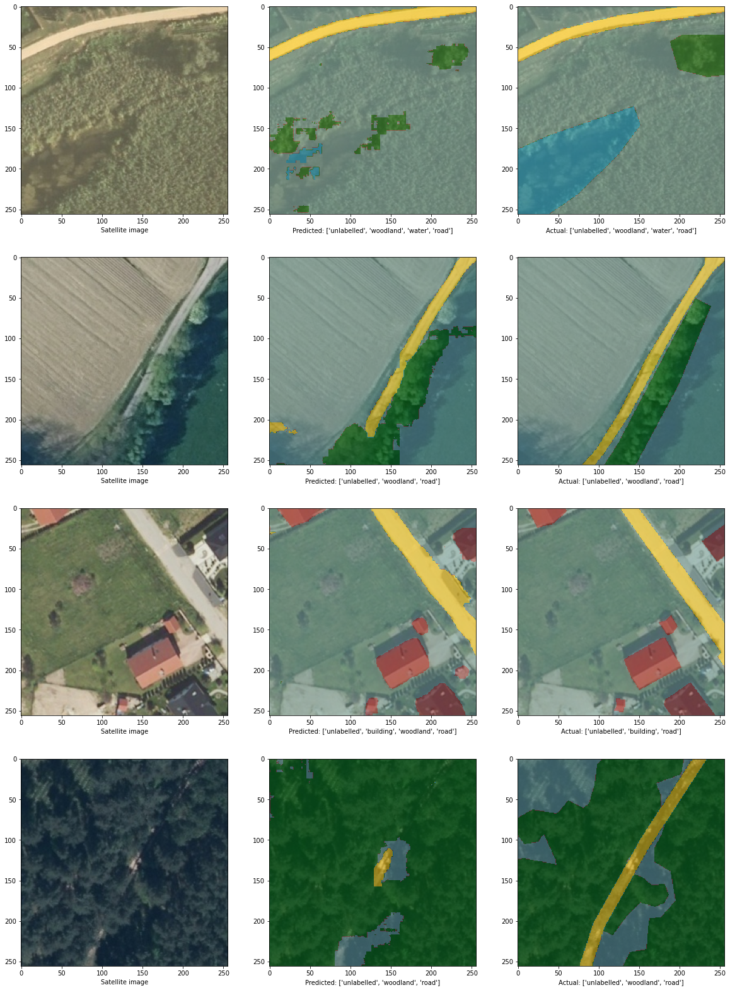

Evaluation
GROUND TRUTH
BASIC
UNET
34226 Training Images
2013 Validation Images
1007 Test Images
Notes:
https://www.v7labs.com/blog/image-segmentation-guide

Slide 19
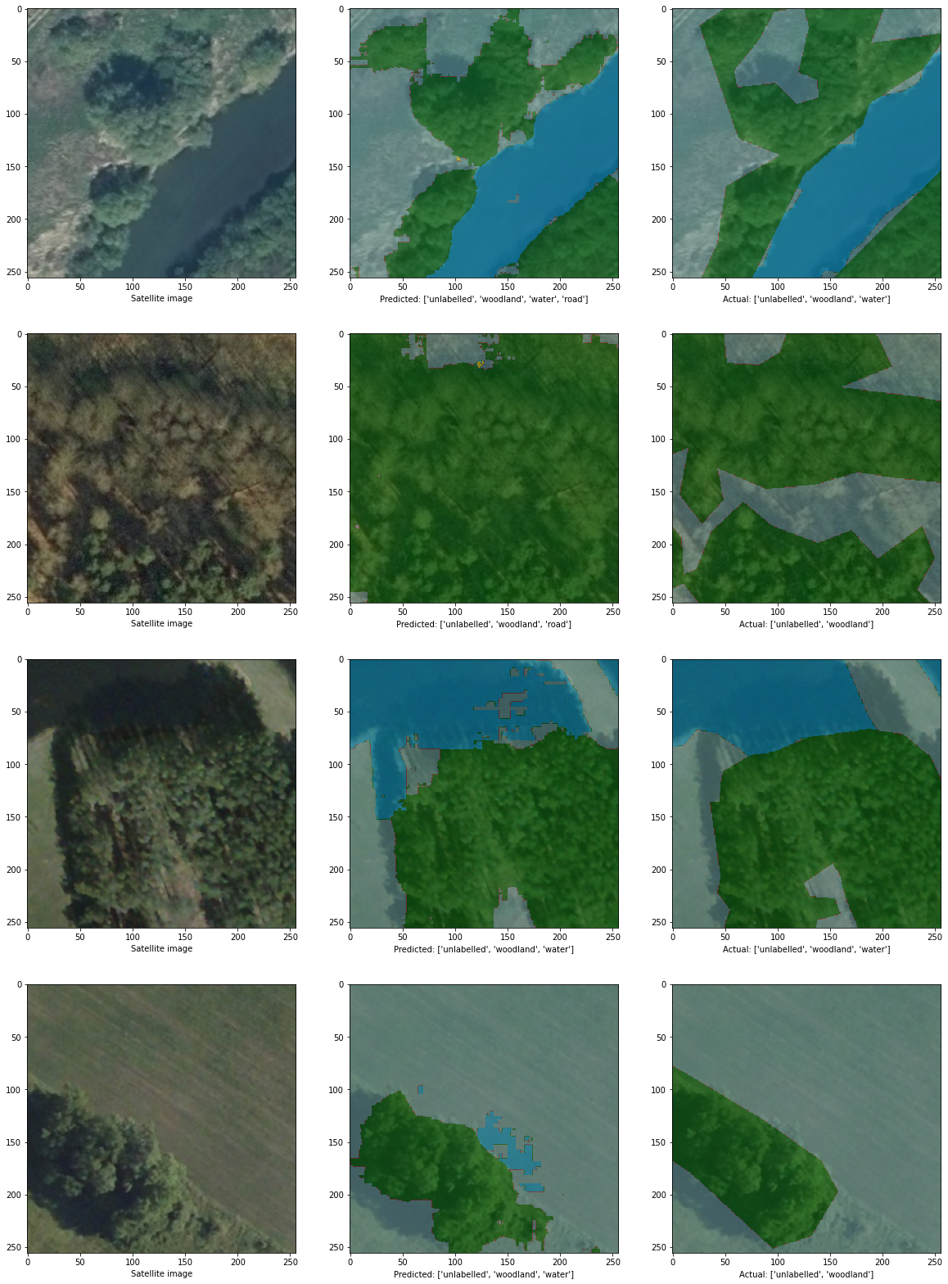
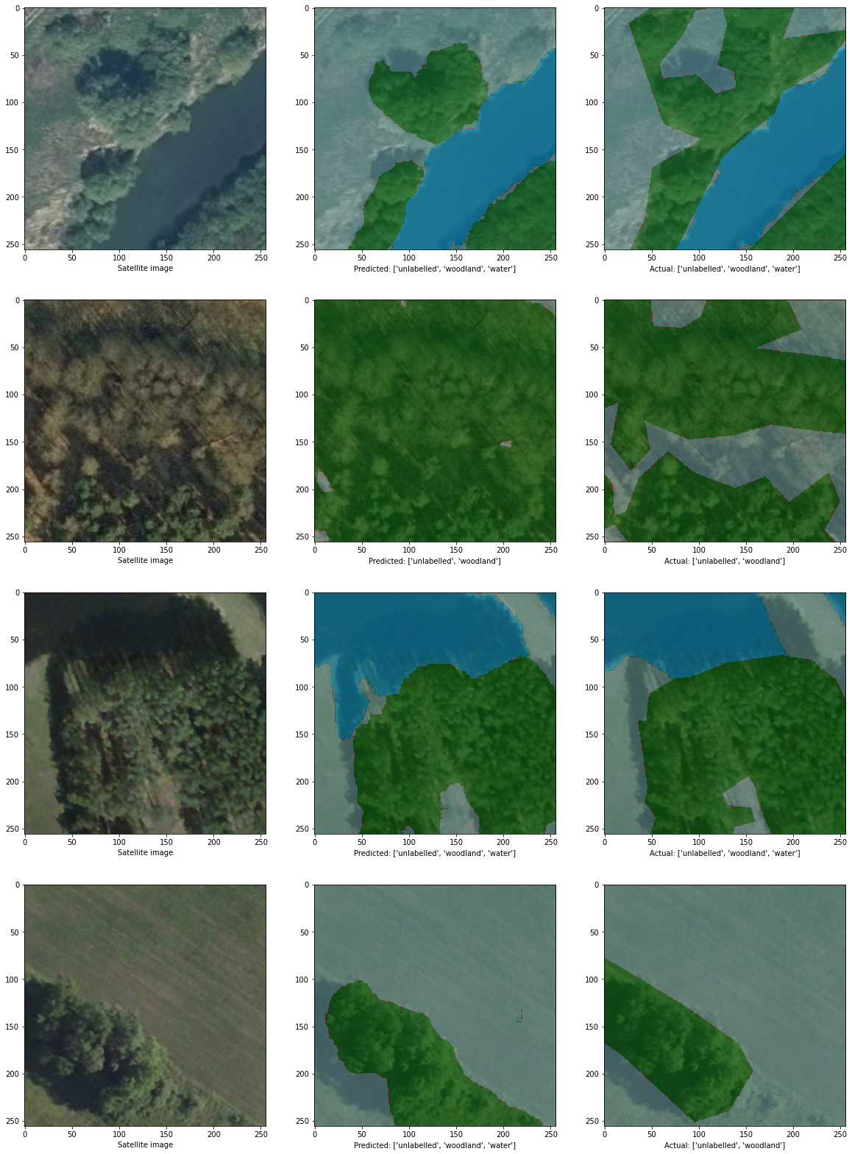
Evaluation
GROUND TRUTH
BASIC
UNET
34226 Training Images
2013 Validation Images
1007 Test Images
Notes:
https://www.v7labs.com/blog/image-segmentation-guide

Slide 20
DEMONSTRATION

Slide 21
Conclusion
04
What are the limitations and future explorations?

Slide 22
Limitations
Prediction:
Does not handle overlapped objects well, i.e. tree over road
Does not pick up areas where separation between objects are not as apparent
Dataset:
Unlabelled class consists of grassland, concrete paving, shadow, etc.
Some ground truth labelling are inaccurate
Only consists of some areas in Poland
Mostly forested and rural areas
34226 Training Images
2013 Validation Images
1007 Test Images
Notes:
https://www.v7labs.com/blog/image-segmentation-guide

Slide 23
Future Explorations
Explore other architectures and pretrained models
Increase variety of datasets to include a fair representation of urban, rural, and different types of natural landcovers
Better labelled training sets
34226 Training Images
2013 Validation Images
1007 Test Images
Notes:
https://www.v7labs.com/blog/image-segmentation-guide

Slide 24
THANKS!
Please keep this slide for attribution

